Slide 1
INTERFACE WITH RASPBERRY PI
STUDENT INFORMATION
AMONJOT SINGH CHHINA
C0772326 GROUP 1

Slide 2
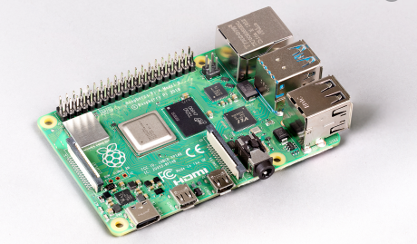
Introduction
In this ppt step by step guide for connecting raspberry pi to host machine is given using SSH link through Putty and Command prompt and then updating and upgrading the software to the latest version

Slide 3
Specifications of Raspberry pi 4
Broadcom BCM2711, Quad core Cortex-A72 (ARM v8) 64-bit SoC @ 1.5GHz
2GB, 4GB or 8GB LPDDR4-3200 SDRAM (depending on model)
2.4 GHz and 5.0 GHz IEEE 802.11ac wireless, Bluetooth 5.0, BLE
Gigabit Ethernet
2 USB 3.0 ports; 2 USB 2.0 ports.

Slide 4
Specifications of Raspberry pi 4
Raspberry Pi standard 40 pin GPIO header (fully backwards compatible with previous boards)
2 × micro-HDMI ports (up to 4kp60 supported)
2-lane MIPI DSI display port
2-lane MIPI CSI camera port
4-pole stereo audio and composite video port
H.265 (4kp60 decode), H264 (1080p60 decode, 1080p30 encode)

Slide 5
Specifications of Raspberry pi 4
OpenGL ES 3.1, Vulkan 1.0
Micro-SD card slot for loading operating system and data storage
5V DC via USB-C connector (minimum 3A*)
5V DC via GPIO header (minimum 3A*)
Power over Ethernet (PoE) enabled (requires separate PoE HAT)
Operating temperature: 0 – 50 degrees C ambient

Slide 6
REQUIRED APPARATUS FOR STARTING UP
Raspberry pi 4
Ethernet Cable
Micro SD card
SD card adapter
Laptop/ Host machine

Slide 7
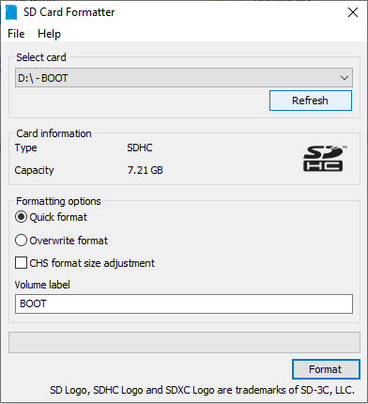
STEP 1: Formatting the SD card
We need to format the sd card before using it to get rid of the unwanted files or cache present in SD card and in order to do that we need to download a SD card formatting software and we are using the one by sdcard.org and doing overwrite format instead of quick format

Slide 8
STEP 2: Downloading the image
Raspberry pi need to be installed with latest image before usage and in order to do that we will download latest image from the raspberry pi website and out of three options(Raspberry Pi OS with desktop and recommended software, Raspberry Pi OS with desktop, Raspberry Pi OS Lite) We will download the Raspberry Pi OS lite for now because we are not using monitor with raspberry for now and we can download the software according to system requirements

Slide 9
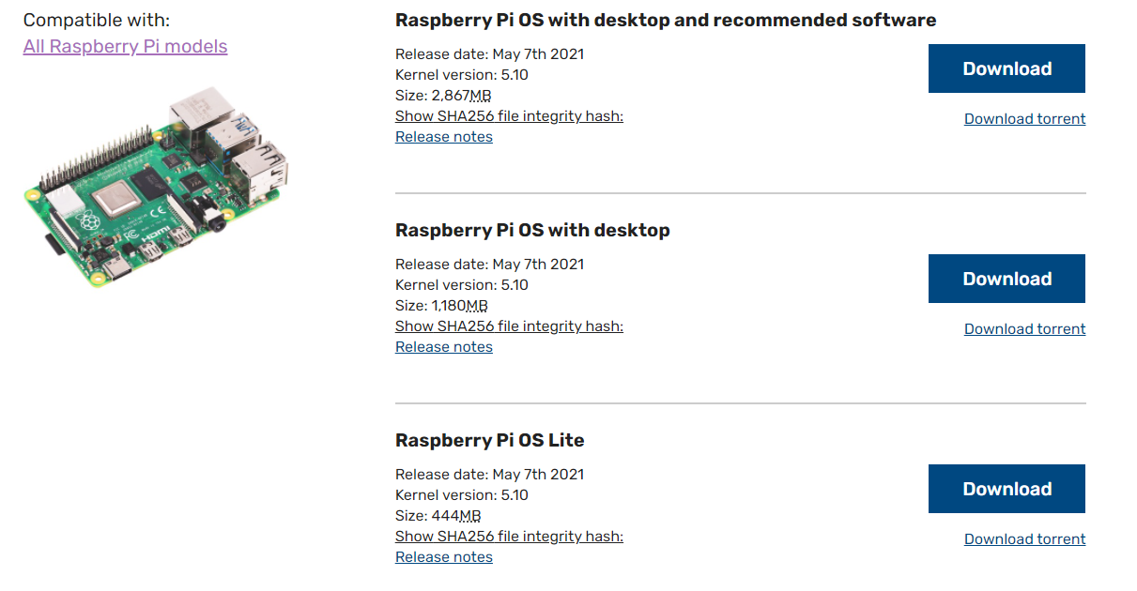
STEP 2: Downloading the image

Slide 10
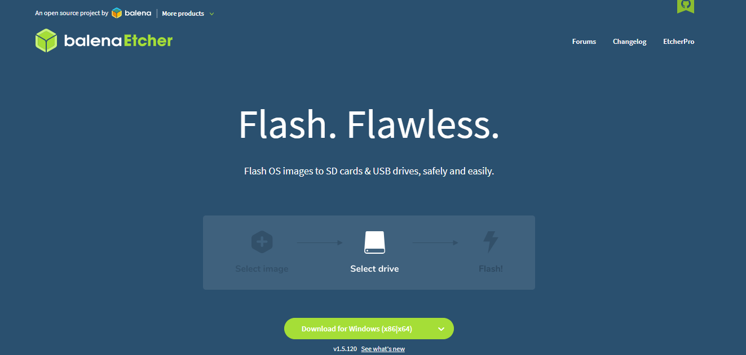
STEP3 : Downloading Image Building Software

Slide 11
STEP3 : Downloading Image Building Software
A image building software would be required to build the latest image for raspberry pi and we will use the Balena Etcher image building software and in order to download the Balena Etcher image building software we need to download the software from Balena.io and then selecting balena etcher from resources

Slide 12

STEP3 : Downloading Image Building Software

Slide 13
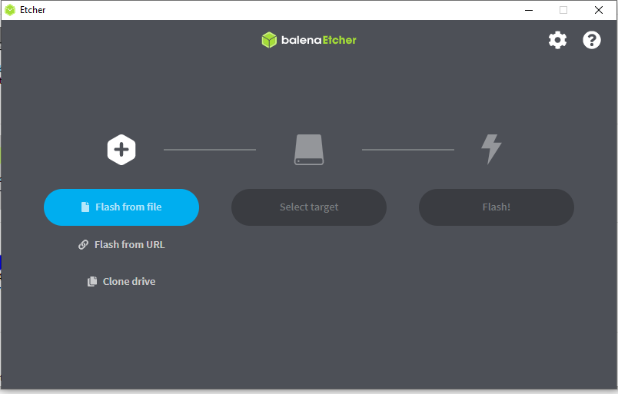
STEP3 : Downloading Image Building Software

Slide 14
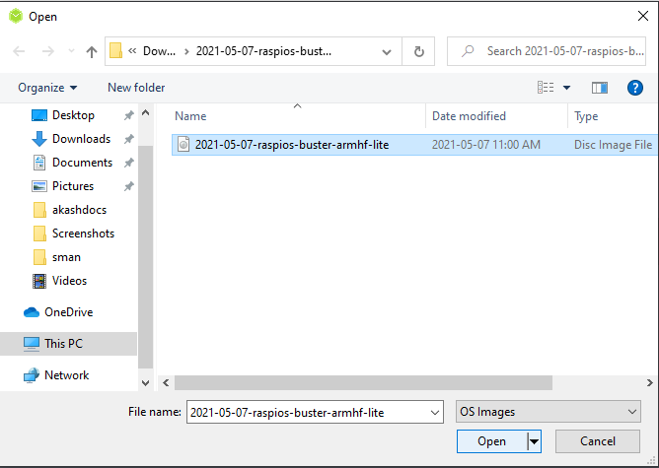
STEP3 : Downloading Image Building Software

Slide 15
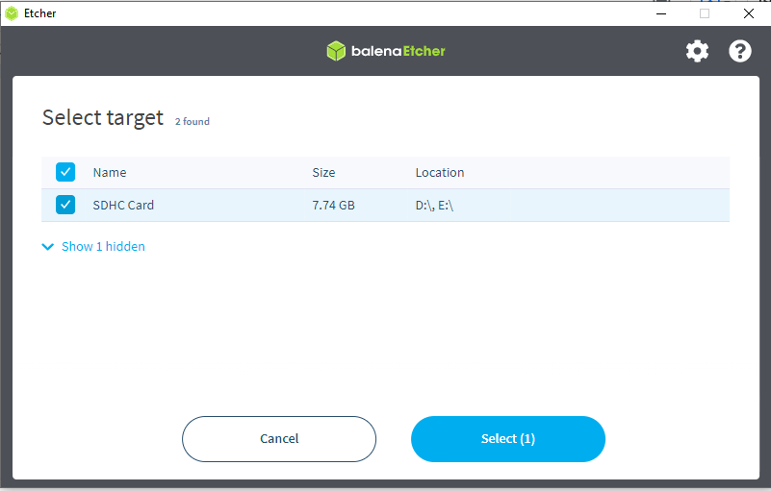
STEP3 : Downloading Image Building Software

Slide 16
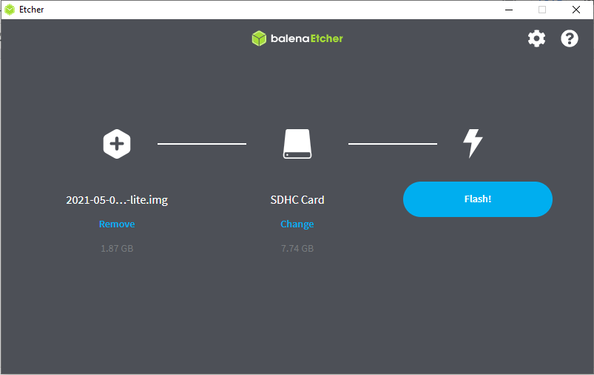
STEP3 : Downloading Image Building Software

Slide 17
Making the connections
Now we have SD card ready with latest image we need to make the physical connections including
Inserting SD card inside Raspberry pi
Connecting Ethernet cable to Raspberry pi
Connecting USB cable to Raspberry pi that will act as connection wire as well as power source

Slide 18
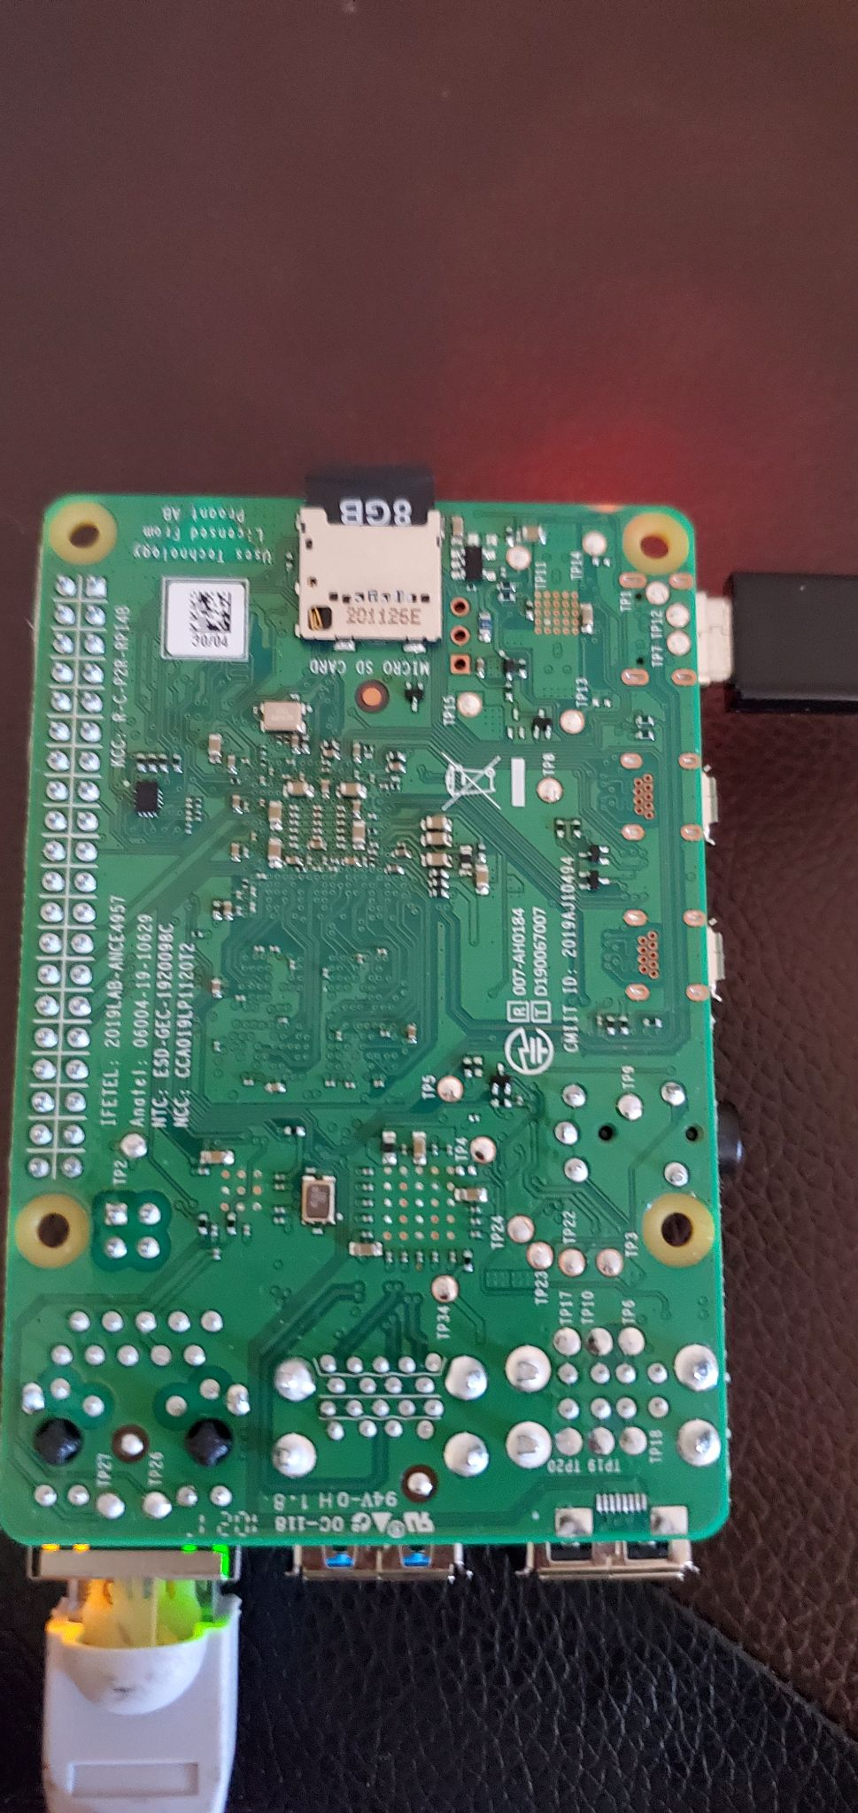
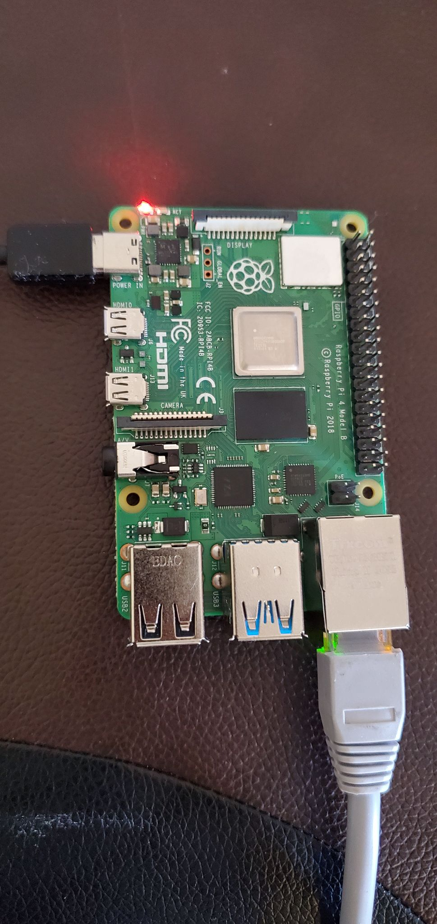
Making the connections

Slide 19
Connecting to Raspberry Pi Using Putty
Using putty is one of the two ways we will be using to connect to raspberry pi and in order to do that we will need to download the putty software from the official website followed by installation and setting up the SSH link through putty interface

Slide 20
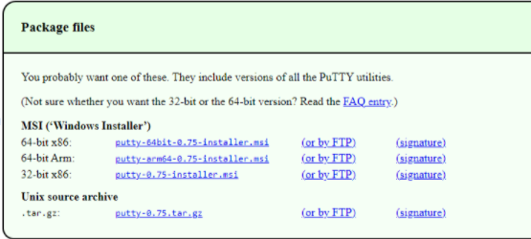
Connecting to Raspberry Pi Using Putty

Slide 21
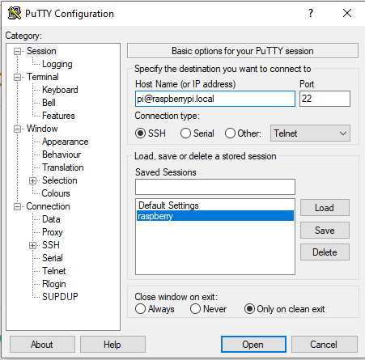
Connecting to Raspberry Pi Using Putty
To set up Putty we need to enter the hostname as pi@raspberrypi.local and choose the connection type ssh and we can choose to save the settings so we do not need to setup the configuration every time we are using Putty after saving we need to click on load followed by Open and that will open the putty terminal

Slide 22
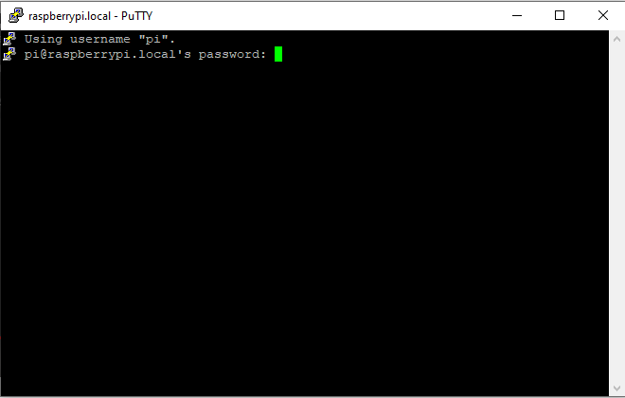
Connecting to Raspberry Pi Using Putty
We need to enter the default password here which is ‘raspberry’

Slide 23
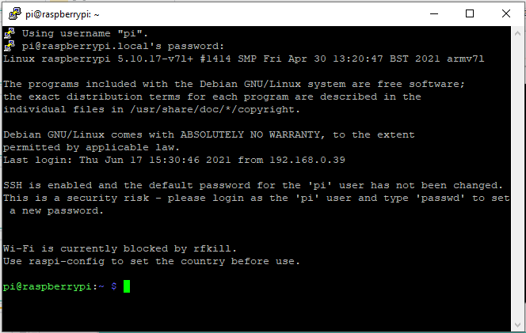
Connecting to Raspberry Pi Using Putty

Slide 24
Connecting to Raspberry Pi Using Command Prompt
Command prompt is the second method we will use to connect to Raspberry pi in windows and in order to connect to raspberry pi using command prompt we will use SSH link through the command ssh pi@raspberrypi.local

Slide 25
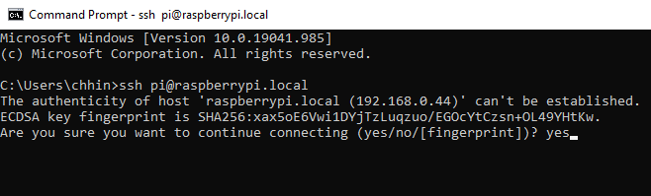
Connecting to Raspberry Pi Using Command Prompt
Type yes and then press enter to continue the connection

Slide 26
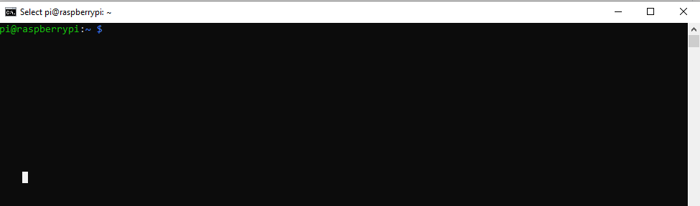
Connecting to Raspberry Pi Using Command Prompt
After the last step we will have raspberry pi running and ready to use

Slide 27
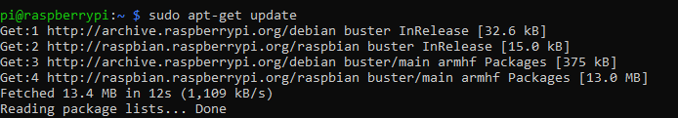
Updating the Raspberry pi
We need Raspberry pi to be installed with latest updates in order to use it. To update the raspberry pi we would use the command sudo apt-update and then press enter and we will get the updates

Slide 28
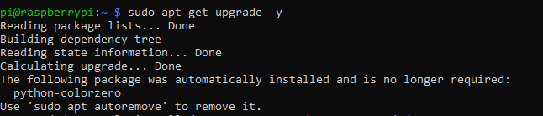
Upgrading the Raspberry pi
After updating the Raspberry pi we also need to upgrade that will upgrade the kernel to latest version, it can take around 10-20 minutes

Slide 29
VNC viewer
Vnc viewer is used to access raspbian without the use of additional monitor. Raspbian can be accessed through host machine. In order to do that we need login to raspberry pi using putty or command prompt and then use the command VNS server a ips level would be created to access the raspbian.

Slide 30
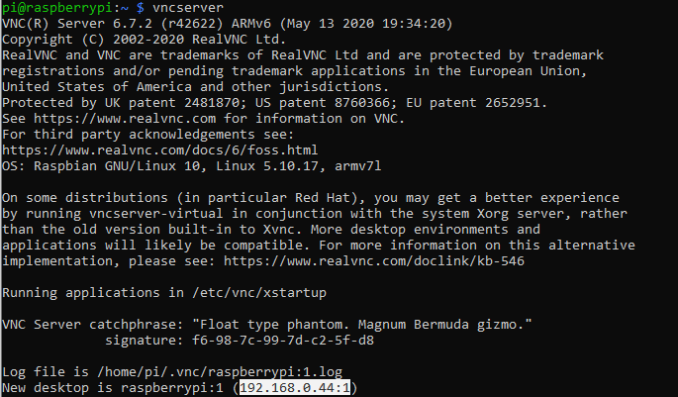
VNC viewer

Slide 31

VNC viewer
Add the ip address to the VNC viewer application and a login window would appear and we have to enter the id and password Id- pi password- raspberry and we would be able to access to VNC viewer

Slide 32
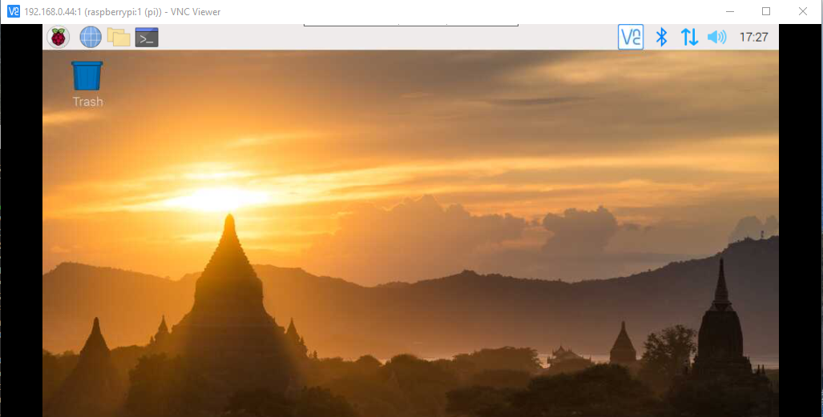
VNC viewer

Slide 33
THANK-YOU

Slide 34
References
Download PuTTY: latest release (0.75). (n.d.). https://www.chiark.greenend.org.uk/~sgtatham/putty/latest.html
Raspberry Pi. (n.d.). Operating system images. Raspberry Pi. https://www.raspberrypi.org/software/operating-systems/
The complete IoT fleet management platform. balena. (n.d.). https://www.balena.io/

Slide 35
References
SD Memory Card Formatter for Windows Download: SD Association. SD Association | The SD Association. (2021, March 17). https://www.sdcard.org/downloads/formatter/sd-memory-card-formatter-for-windows-download/.
Raspberry pi model 4 tech specs(n.d) https://www.raspberrypi.org/products/raspberry-pi-4-model-b/specifications/

